Slide 1
BRÜCKNER MASCHINENBAU
Stretching the Limits
http://www.brueckner.com/
http://tiny.cc/brueckner

Slide 2

About
Matthias Kappeller
Team Leader Software Development at Brückner Maschinenbau
@mkappeller

Slide 3

About
Johannes Brandstetter
Chef de Cuisine at MongoSoup
@loomit

Slide 4
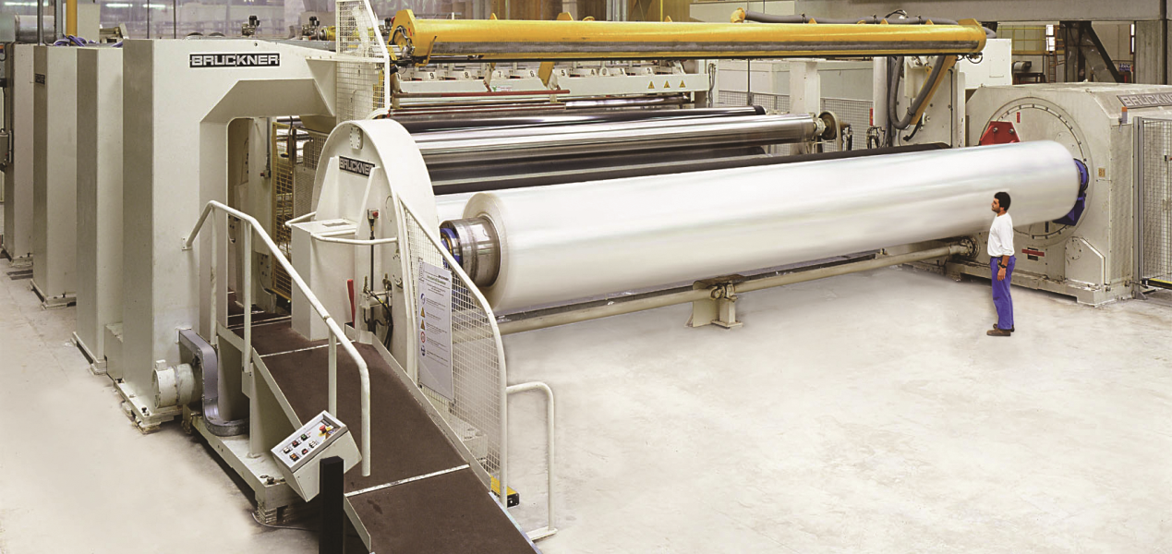
We Build the Largest Lines in the Industry
BOPP 10.4m (35ft) – winder

Slide 5
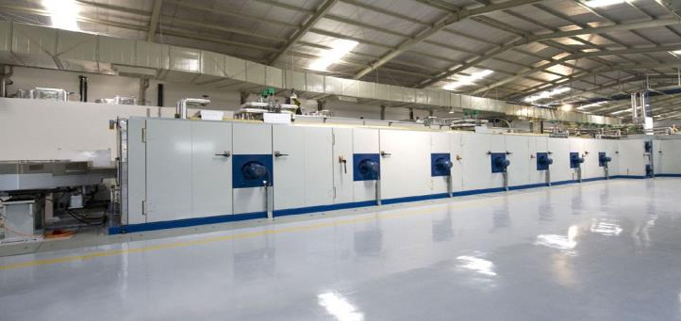
We Build the Fastest Lines in the Industry
TDO of a 8.7 m BOPP line – 525 m/min production speed

Slide 6
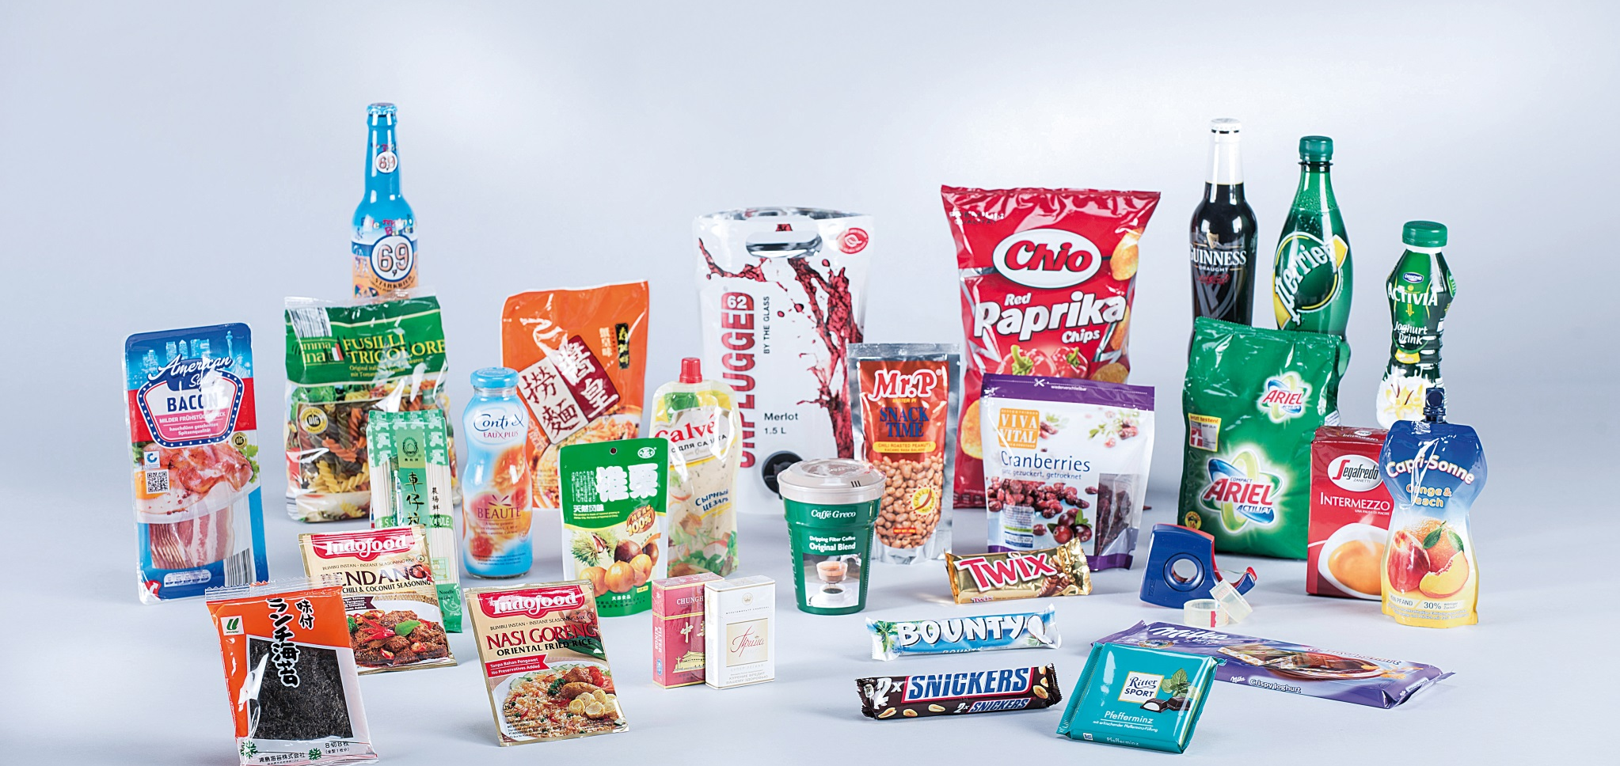
Are You in Packaging Films?

Slide 7

Are You in Technical Films?

Slide 8
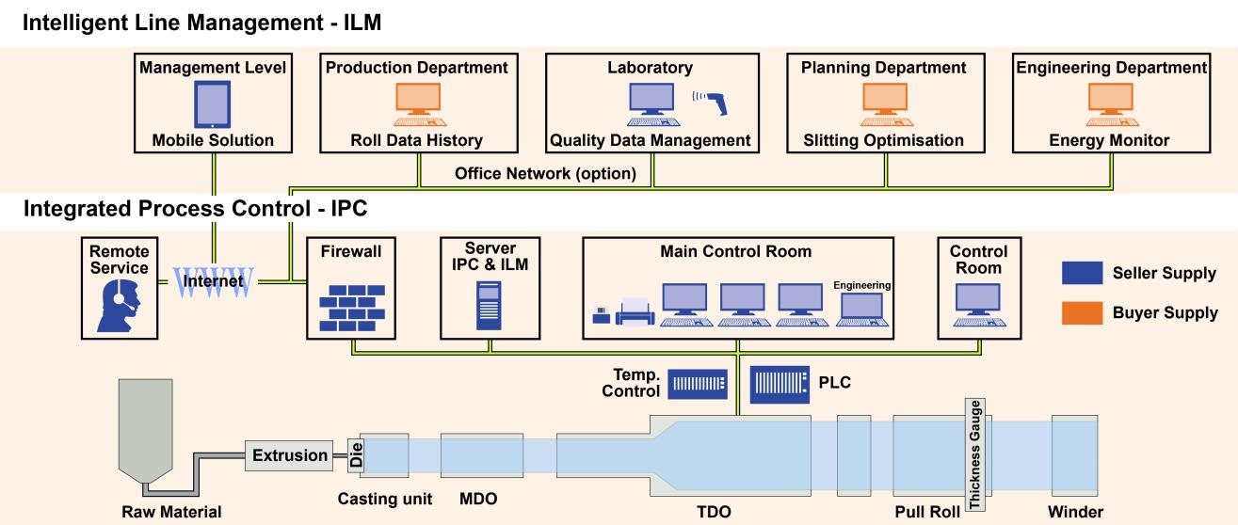
How we deploy our products

Slide 9
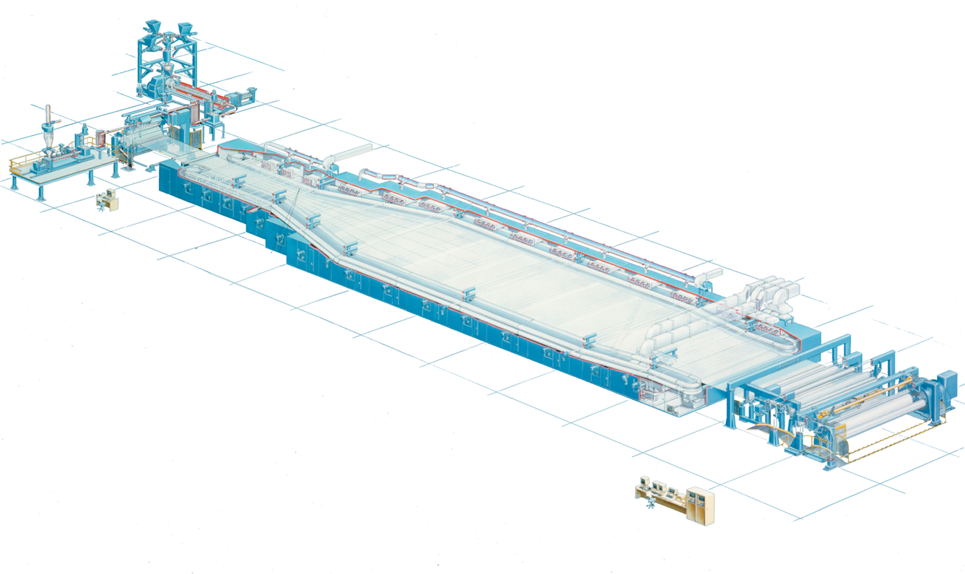
Sensor Data
010010100111 010101101101 10110101 1011
Notes:
Parameters to adjust/control the machine parts
Parameters to monitor the production process/status
Parameters to garantee product-quality to the customer
Parameters to identify broken machine parts
Parameters to manage consumption and energy

Slide 10
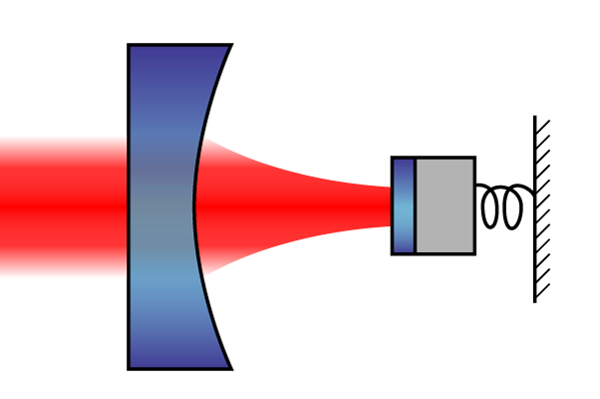
~100'000 Datapoints per Line
1-8 lines per customer
Temperature
Speed
Pressure
Thickness
Density
Alarms
Sensor-Status
Notes:
TODO: Frequency of datapoints
We actually read all these datapoints already (without you couldn‘t control the production process)
BUT only for a minority (~1‘000) we keep the history (>1Year)
Problems with Performance/System-Stability
This is the link to MongoDB

Slide 11
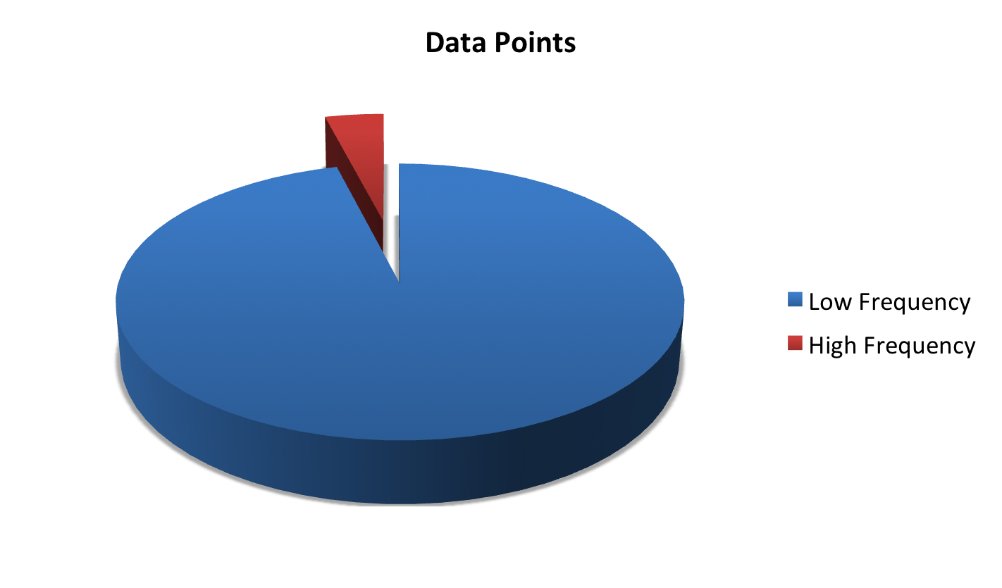
Sensor Data
~100000 data points in total
~4000 variables are high frequency

Slide 12
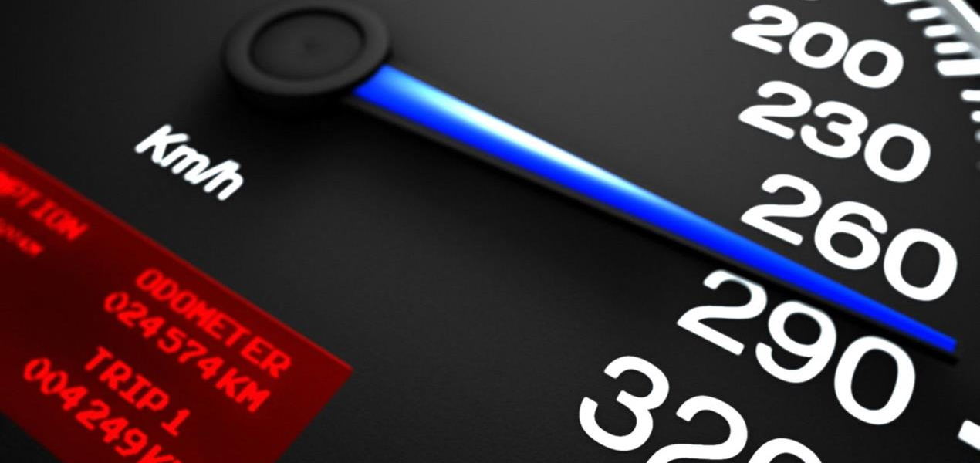
Sensor Data
Frequency of incoming data at 5-10Hz (100-200ms)
http://www.fantom-xp.com/en_19__Intel_Core_i7_high_speed.html

Slide 13
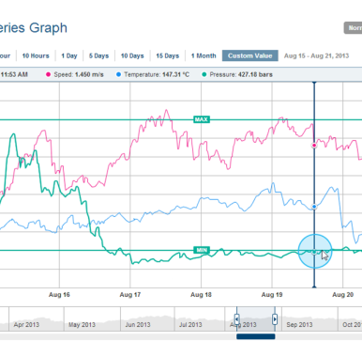
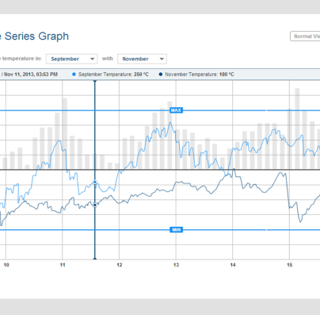
Sensor Data
Time Series Graph
Track Single Parameter

Slide 14
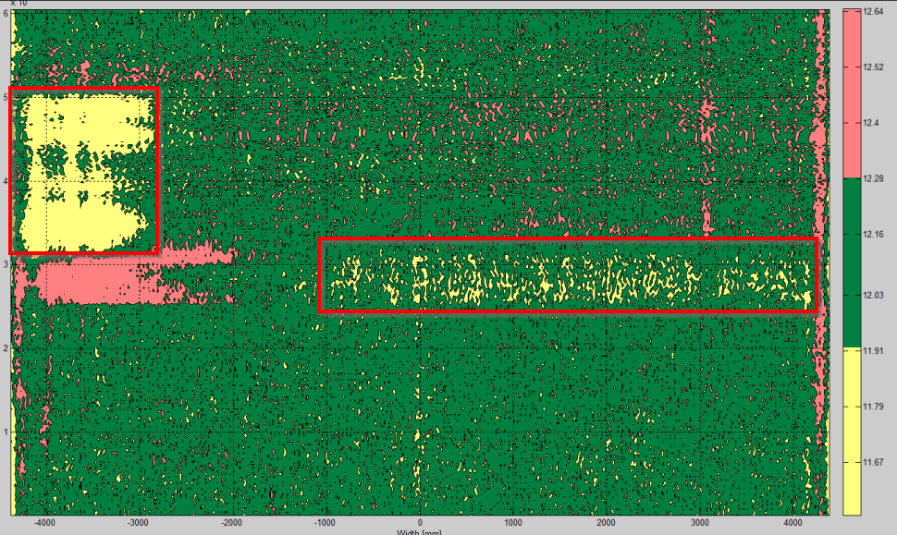
Scanner Data
Document for every product of a campaign
Quality Profile
Thickness Scan
Scan speed: 300-500 m/min
Analyzed via Heatmap

Slide 15
Our current approach and its problems
Difficult and time-consuming configuration and setup
Typical ETL (information loss)
Many Stored-Procedures
Low performance
Low availability
Outdated UI-Technology (Delphi)
Proprietary PLC-Driver (to read sensor data)

Slide 16

Near Future Goals
High performance
Write > 3'000 updates / sec
Read > 2 queries / sec
Scalability
Low System-Complexity
Notes:
Of course performance!
The system has to scale from 1 to 8 lines, from 100‘000 to 800‘000 datapoints
Without increasing the system-complexity (Managable by non-IT-Administrators, no IT-Education)
This will be a quick-win for us
But if possible (and we hope it is) we wanna take the next step
Next Slide

Slide 17
Far Future Goals
Intelligent Line
Management Cockpits
Smart Recipes
Notes:
We wanna get close to an „Intelligent Line“
Easier Recipies-Management
Easier Error-Tracing
Machine-Learning

Slide 18
Challenges
OEM
Customer has no IT-Administration or low IT-KnowHow
Low-Cost Server Infrastructure
Highly scalable Server infrastructure
Bad network connection
Many power shutdowns
Production 24/7
High availability
Complex system update
Notes:
Low-Cost: multiple clusters (even three) may not be accepted. Maybe we have to use HDD if they are cheapter (vs. SDDs)

Slide 19

PoC
http://farm8.static.flickr.com/7396/8718123610_09e70f6d90.jpg
Notes:
And we brought in a partner to mach our vision, our challanges, our goals with the knowledge of a technology-know-how leader
=>

Slide 20
MongoDB

Slide 21

MongoDB Hosting from Germany Bring your own data center Customer-focused solutions

Slide 22
Web based management tools Real-time visualization Real-time logging SSL connector

Slide 23




Notes:
First German MongoDB Partner (earl 2012)
First German MongoDB Hosting Partner (Mid 2013)

Slide 24


Reasons for choosing MongoDB
Schema free
Ease and speed of development
Ease of operations
Realtime analysis of streaming data
Possibility to add Hadoop for heavier Analytics later
Notes:
Got to know Brückner at Hadoop User Group
Were brought in to help in finding a data managment platform
Looked at Cassandra/Hbase: too complex

Slide 25
Architecture Overview (simplified)
Streaming Data
Streaming Data
MongoDB
OPC
Data Input Streaming
REST
Analytics
Document Data
Hadoop
Scan / Lab Data
Machine Configuration
Recipe
MetaData Service
Notes:
2 types of data
Sensor data -> streaming
Document data -> scans/lab data, used as meta data for queries
MongoHadoop Connector can be used for analytics (or Aggregation Framework, pluggable)
Important part schema design for input streaming
OPC – Standard for Process Control

Slide 26
Schema Design
Time Series Schema
Bucket Schema
“Simple Schema” : one document per event
Notes:
We looked at three different schema designs
Time series seemed to be a good fit
Came up with bucket model later
Question arose why not to use a simple schema -> one document per event

Slide 27
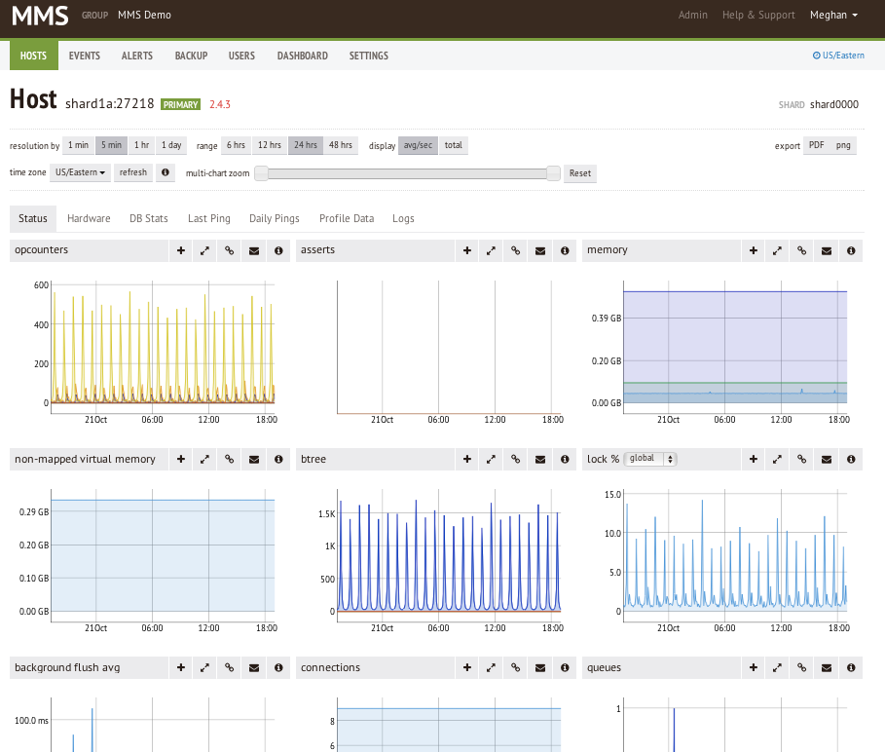
Schema Design
http://blog.mongodb.org/post/65517193370/schema-design-for-time-series-data-in-mongodb
Notes:
Screenshot from MongoDB Managment Service
Used to display metrics from mongodb installations (who of you knows this?)

Slide 28
Schema Design “time series”
{ _id: {timestamp_hour: ISODate("2013-10-10T23:00:00.000Z"), type: “velocity_m1”},
values: { 0: { 0: 93, 1: 91, …, 59: 95 }, 1: { 0: 95, 1: 89, …, 59: 87 }, …, 59: { 0: 91, 1: 90, …, 59: 92 } }
}
db.metrics.update( { _id.timestamp_hour: ISODate("2013-10-10T23:00:00.000Z"), _id.type: “velocity_m1” }, {$set: {“values.59.59”: 92 } } )
Notes:
One document per hour (timestamp_hour)
One subdocument per minute
Key in subdocument used for second in minute

Slide 29
Schema Design “time series” schema: Performance
Preallocate space with empty documents for upcoming time periods -> in-place updates
Primary Index: timestamp
Good fit for streaming data
But lots of sparse documents in our scenario
Notes:
Well known schema, good blog post, lots of hits on google (150k hits for mongodb time series data)

Slide 30
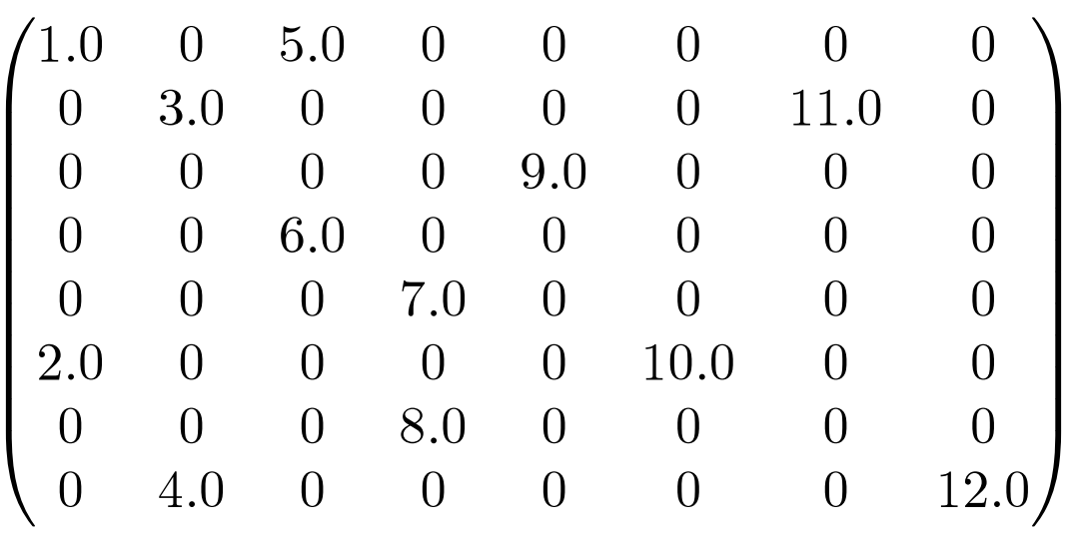
Schema Design “time series”
http://www.culatools.com/wp-content/uploads/2011/09/sparse_matrix.png
Notes:
Sensors have own thresholds, don’t send data that often, sometimes “burst” values, lab/scan data doesn’t fit at all

Slide 31
Schema Design
Schema design for time series data well understood
Sensor Data is not time series data
Sensors have own thresholds

Slide 32

Schema Design “bucket” schema
http://flickr.com/photos/99255685@N00/2063575447

Slide 33
Schema Design “bucket” schema
“A bucket is most commonly a type of data buffer or a type of document in which data is divided into regions.“http://en.wikipedia.org/wiki/Bucket_(computing)

Slide 34
Schema Design “bucket” schema
Have one bucket per sensor type
Fill up with values till it‘s full
Use next bucket

Slide 35
Schema Design “bucket” schema
{ _id: {timestamp_start:ISODate("2013-10-10T23:00:00.000Z"), type:“velocity_m1”
},
state: “OPEN”, values: [ { t: 456, v: 93 }, { t: 572, v: 89 }, …, { t: 2344, v: 92 }
{ t: -1, v: 0 }, ...]
}
db.metrics.update( {_id.timestamp_start: ISODate("2013-10-10T23:00:00.000Z"), _id.type: “velocity_m1” }, {$set: {“values[761]”: {t: 2500, v: 90}} )
Notes:
Timestamp_start: timestamp of first value (when the bucket was „opened“
Timestamp_end: last timestamp (when the bucket was „closed“
State: open/closed: if the bucket is full

Slide 36
Schema Design “bucket” schema: Performance
Preallocate space with empty documents for upcoming data count -> in-place updates
Different bucket sizes for different sensors
Still good for range based queries
Have to keep counter in app to determine bucket state
Good fit for sparse data

Slide 37
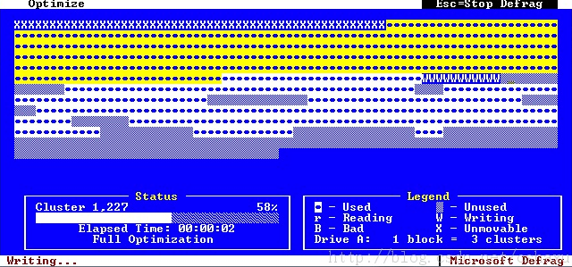
Bucket Schema vs. Simple Schema
Fragmentation
disk and memory will get fragmented over time
even more so the smaller the documents are
Notes:
Depends on data retention (maybe different strategies for different sensors)

Slide 38
Performance
Update driven vs. insert driven
individual writes are smaller
performance and concurrency benefits
Notes:
Update: no overhead for generating new documents, can preallocate documents
Update: you just write the value (not type, status, etc)

Slide 39
Bucket Model vs. Simple Schema
Index Size
Bucket decreases index size by factor of number of documents it holds
Index should fit in RAM + working set
Index updates cause locks and I/O
Notes:
Index on timestamp_start and timestamp_end, that‘s what you query for
The larger the bucket, the smaller the index

Slide 40
Bucket Model vs. Simple Schema
Read Performance
Simple Schema: Document per event: 3600 reads
Bucket Schema: Document per minute: 60 reads
Read performance is greatly improved
Optimal with tuned block sizes and read ahead
Fewer disk seeks
Fewer random I/O
Notes:
All events for one sensor in one hour: 3600 document reads in simple schema, 60 document reads with a bucket size of 60

Slide 41
Hardware Challenges
Growth of data
Data retention
HW belongs to customer, can’t upgrade
Support for legacy MongoDB versions
Notes:
Roughly 2TB/year per machine depending on data points and update frequency
“We want to keep everything -> up to 40TB data in the lifetime of a machine”
Need to use VMs

Slide 42
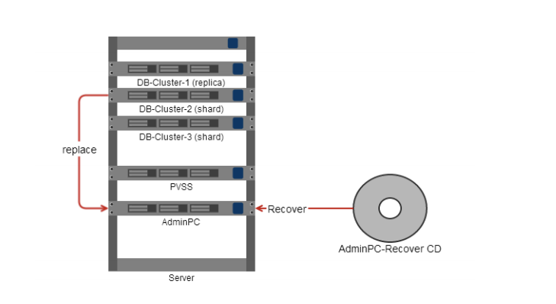
Hardware Overview

Slide 43
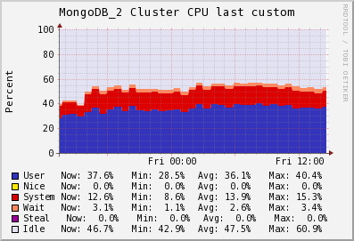
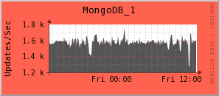
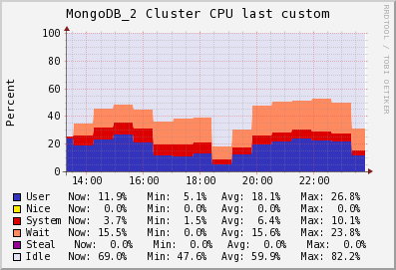
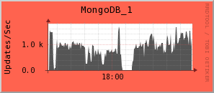
SSD vs. HDD
SSD
HDD
Notes:
You want SSDs, but expensive (in context of project) (11Mio $ per machine, only tiny amount for hardware)

Slide 44
Lessons learned
Schema design matters
Increase performance:
In-Memory caching
Concurrency
Queue
Core-Sharding
Flexible and scalable system
We can build a system with low complexity for simple use cases
We can provide a system for „bigger“ use cases by increasing complexity
Notes:
queueing, caching, multi-threaded ging alles hand in hand (alles in-memory) und manuell. Was aber in produktion durch spring-integration (theoretisch auch durch ein anderes ESB wie Apache Camel)
du könntest sagen - ESB in production recommended - und wir werden uns für Spring-Integration entscheiden weil's sich besser von der Architectur integrieren lässt.
Core sharding might become unnecassary in newer versions of MongoDB

Slide 45
Conclusion
Development of appliance like systems can be challenging
Ease of use
Resilience

Slide 46
Where we are now
PoC and its results approved by management
Workout / Design the UI/UX
Develop the software system
Ship prototypes to some sites
Explore and develop analytic-algorithms
Fieldtest for our software system with MongoDB
First machine with this solution to be deployed in 2016

Slide 47
Questions?
Don’t forget to grab a free MongoSoup T-Shirt

Slide 48

@mongosoup
www.mongosoup.de

